Slide 1
COMP 4500
Week 10 - Monday

Slide 2
Last time
What did we talk about last time?
Sequence alignment

Slide 3
Questions?

Slide 4
Assignment 5

Slide 5
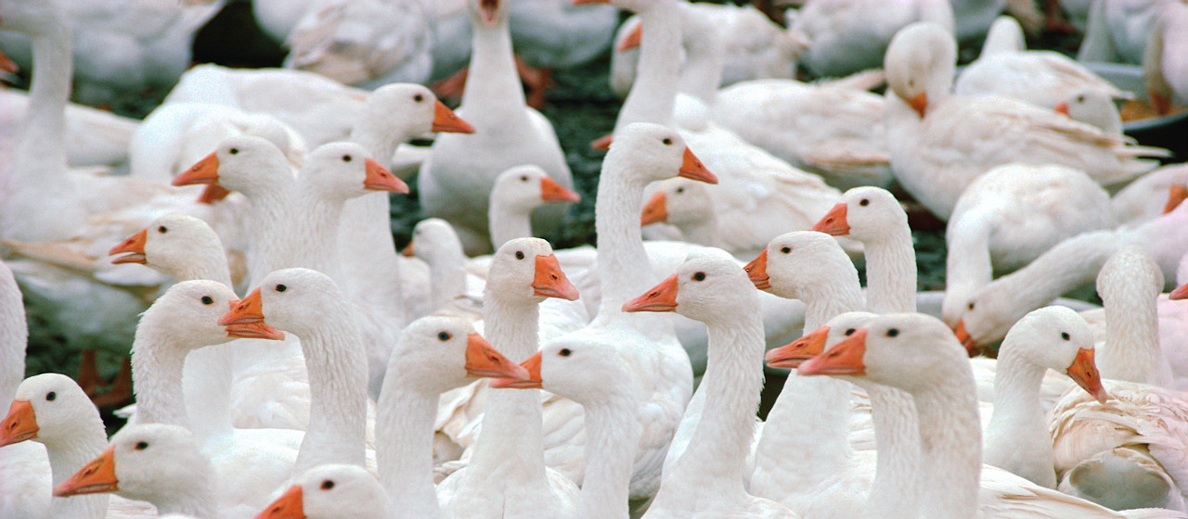
Logical warmup
A butcher goes to the market with $100
He has to buy exactly 100 animals (for no especially good reason)
There are cows, geese and chicken for sale
Cows are $15 each
Geese are $1 each
Chickens are $0.25 each
He has to buy at least one of each animal and has to spend all his money
What does the butcher buy?

Slide 6
Back to Sequence Alignment

Slide 7
Table A of OPT values
0 | 0 | δ | 2δ | … | (j -1)δ | jδ | … | nδ
1 | δ
2 | 2δ
 | …
i – 1 | (i-1)δ
i | iδ
 | …
m | mδ
 | 0 | 1 | 2 | … | j - 1 | j | … | n

Slide 8
Sequence alignment example
Find the minimum cost to align:
"machine"
"catching"
The cost of an insertion (or deletion) δ is 1
The cost of replacing any letter with a different letter is 1
The cost of "replacing" any letter with itself is 0

Slide 9
Fill in the table
 |  | m | a | c | h | i | n | e
 | 0 | 1 | 2 | 3 | 4 | 5 | 6 | 7
c | 1
a | 2
t | 3
c | 4
h | 5
i | 6
n | 7
g | 8

Slide 10
Three-sentence Summary of the Maximum-Flow Problem and the Ford-Fulkerson Algorithm and Minimum Cuts

Slide 11
Maximum Flow

Slide 12
Flow networks
A flow network is a weighted, directed graph with positive edge weights
Think of the weights as capacities, representing the maximum units that can flow across an edge
It has a source s (where everything comes from)
And a sink t (where everything goes to)
Some books refer to this kind of flow network specifically as an st-flow network

Slide 13
Flow
The definition of s-t flow is a function f(e) that maps a non-negative real number to each edge e meeting the following conditions:
Capacity condition: No edge has more flow mapped to it than its capacity c(e), more formally 0 ≤ f(e) ≤ c(e)
Conservation condition: Except for s and t, the flow coming into a node v is the same as the flow going out
These conditions are intuitive: You can't pump more through a pipe than its capacity and material doesn't accumulate at a pipe joint

Slide 14
Applications of flow problems
Oil flowing from a start to a destination
Airline crews needed to man aircraft, moving from city to city
Goods being produced by factories and consumed by cities, with roads that can accommodate a certain amount of traffic

Slide 15
Maximum flow
A common flow problem is to find the maximum flow
A maximum flow is a flow such that the amount leaving s and the amount going into t is as large as possible
In other words:
The maximum amount of flow gets from s to t
No edge has more flow than its capacity
The flow going into every node (except s and t) is equal to the flow going out

Slide 16
Flow network
4
a
b
5
3
3
7
4
7
s
c
d
t
6
1
4
6
e
f
5

Slide 17
Augmenting path
Our algorithm involves adding augmenting paths to our graph
A flow augmenting path:
Starts at s and ends at t
May cross some edges in the direction of the edge (forward edges)
May cross some edges in the opposite direction (backwards edges)
Increases the flow by the minimum of the unused capacity in the forward edges or the maximum of the flow in the backwards edges

Slide 18
Terminology
When all the capacity of an edge is used, we say that edge is saturated
After adding an augmenting path, we refer to the new graph (with updated flows) as the residual graph
The capacity left on edges in the residual graph is its residual capacity

Slide 19
Ford-Fulkerson algorithm
Ford-Fulkerson is a family of algorithms for finding the maximum flow
Start with zero flow on all edges
Find an augmenting path (increasing flow on forward edges and decreasing flow on backwards edges)
If you can still find an augmenting path in the residual graph, go back to Step 2

Slide 20
Find a max flow
4
a
b
5
3
3
7
4
7
s
c
d
t
6
1
4
6
e
f
5

Slide 21
Why do we need the rule for backwards edges?
If you don't have the rule for backwards edges, you can sometimes get stuck with more flow left unused
Consider the following example:
u
u
u
20
10
20/20
0/10
20/20
10/10
s
30
t
s
20/30
t
s
10/30
t
10
20
0/10
20/20
10/10
20/20
v
v
v
If we add an augmenting path suvt with 20 units, we'll be stuck, unable to add more to v
By adding an augmenting path svut with 10 units, we pull flow off uv, splitting it back to ut

Slide 22
Why does it work?
An augmenting path is a flow
It never increases a forward edge beyond its maximum
It never decreases a backward edge below 0
The input to each node (other than s and t) continues to be equal to the output
Each augmenting path adds additional flow because more is coming out of s (and going into t)
When you can't find any more augmenting paths, there's no way to add more flow from s to t
Since all weights are integers, we will eventually reach the maximum flow, even if we're only increasing by 1 each time

Slide 23
Running time of Ford-Fulkerson
Our definition of Ford-Fulkerson didn't say how you pick the augmenting path
If the capacities are all integers, each flow value is an integer
An augmenting path will increase the total flow by at least 1 each time
Thus, the algorithm could take O(|E|f), where |E| is the number of edges in the graph and f is the maximum flow
That could be terrible if f has a large numerical value
Edmonds-Karp is a variation of Ford-Fulkerson that uses a breadth-first search to find a shortest augmenting path
It runs in O(|V||E|²)

Slide 24
Minimum Cuts

Slide 25
Cuts
An cut in a graph partitions the graph into two disjoint sets
An st-cut is a cut such that s is in one partition and t is in the other
Think of it as a line that slices through the edges, putting s on one side and t on the other
The capacity of a cut is the sum of the capacities of the edges that the cut divides

Slide 26
Maxflow-mincut theorem
The smallest capacity st-cut you can make has the same capacity as the largest possible st-flow
Intuitively, it's like that cut is a set of edges that most constricts the flow from s to t

Slide 27
Minimum st-cut
4
a
b
5
3
3
7
4
7
s
c
d
t
6
1
4
6
e
f
5

Slide 28
Upcoming

Slide 29
Next time…
Bipartite matching

Slide 30
Reminders
Work on Homework 5
Due Friday by midnight
Read section 7.5

